Slide 1
Computer Science
Mr. Eddie

Slide 2
Agenda

Slide 3

Agenda
Do Now
What’s an IDE?
CodePen Introduction
Walk Through Set-Up
Wireframe & Design
Activity #1
Activity #2
Exit Ticket

Slide 4
Do Now
Answer the following questions:
Open your laptops
Sign on to Google Classrooms
Register to this class
10TH Grade: Classroom Code [ l73tho0 ]
11TH Grade: Classroom Code [ 2ahwrd ]
Answer the question posted to the Classroom:
Describe a time when you solved a problem. What was the problem, and how did you solve it?

Slide 5
Unit 1
Introduction to the Web Development Environment and foundational web design.

Slide 6
Agenda
explore IDE’s (Independent Development Environments) by creating a developer account using codepen.io
Understand basic web design principles, including UX (user experience) and UI (User interface, by reviewing popular website layouts and designs.

Slide 7
Agenda
Do Now
What’s an IDE?
CodePen Introduction
Walk Through Set-Up
Wireframe & Design
Activity #1
Activity #2
Exit Ticket

Slide 8
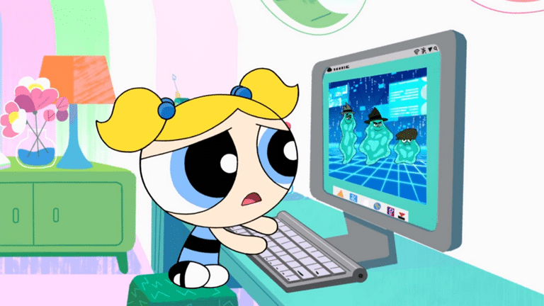
What’s an IDE?
An integrated development environment is a software application that provides comprehensive facilities to computer programmers for software development. An IDE normally consists of at least a source code editor, build automation tools, and a debugger.

Slide 9
Intro To CodePen
LIVE DEMO

Slide 10
Setting Up our IDE [ CodePen ]
LIVE DEMO

Slide 11
Agenda
Do Now
What’s an IDE?
CodePen Introduction
Walk Through Set-Up
Wireframe & Design
Activity #1
Activity #2
Exit Ticket

Slide 12
WireFrame
LIVE DEMO

Slide 13
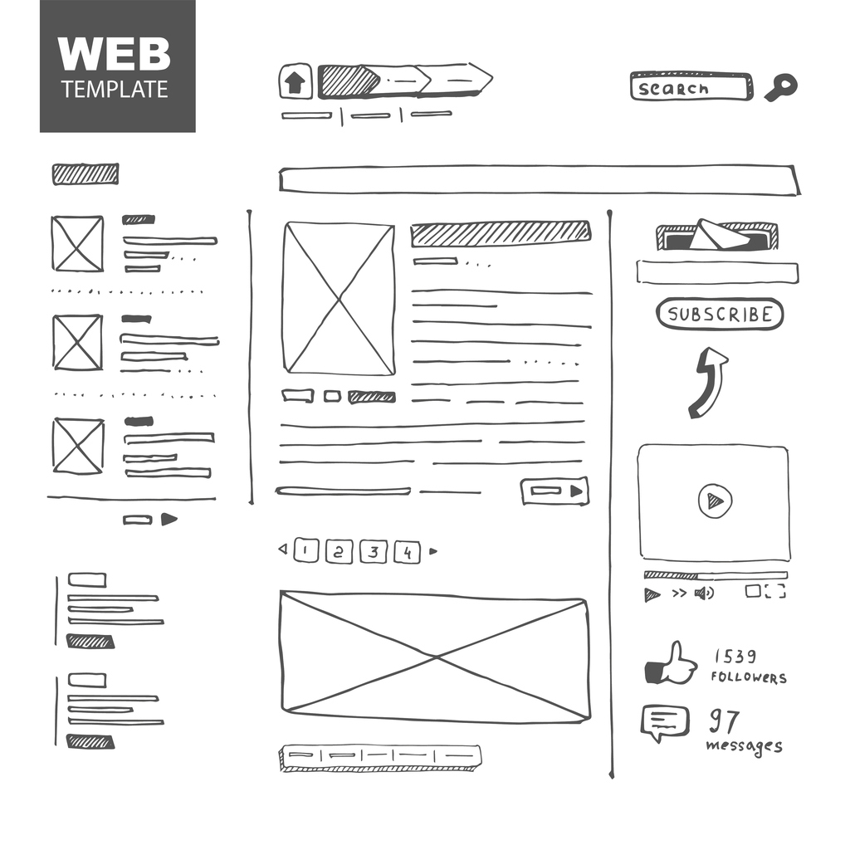

Slide 14
Activity #1
Reverse Wireframe

Slide 15
Activity #2
Wireframe Your Site

Slide 16
Agenda
Do Now
What’s an IDE?
CodePen Introduction
Walk Through Set-Up
Wireframe & Design
Activity #1
Activity #2
Exit Ticket

Slide 17
Exit Ticket

Slide 18
EXIT TICKET
Submit your first website link to the google form shared.
Describe what an IDE is.
Explain the differences between UX and UI.
What is something you learned today that you didn’t know before coming to class?

